Slide 1
MODULE:2
Parametric Learning Algorithms
Learning a Class from Examples — VC Dimension — Noise — Learning Multiple Classes —
Regression: Linear Regression, Multiple Linear Regression, Logistic Regression — Bayes
Classification — Introduction to Neural Networks — Perceptron— Multilayer Perceptron
2

Slide 2
Parametric and Nonparametric Machine Learning Algorithms
Learning a Function
Machine learning can be summarized as learning a function (f) that maps input variables (X) to output variables (Y).
Y = f(x)
An algorithm learns this target mapping function from training data.
The form of the function is unknown, job is to evaluate different machine learning algorithms and see which is better at approximating the underlying function.
Different algorithms make different assumptions or biases about the form of the function and how it can be learned
Parametric Machine Learning Algorithms
Assumptions can greatly simplify the learning process, but can also limit what can be learned. Algorithms that simplify the function to a known form are called parametric machine learning algorithms.
3

Slide 3
The algorithms involve two steps:
Select a form for the function.
Learn the coefficients for the function from the training data.
An easy to understand functional form for the mapping function is a line, as is used in linear regression:
b0 + b1*x1 + b2*x2 = 0
Where b0, b1 and b2 are the coefficients of the line that control the intercept and slope, and x1 and x2 are two input variables.
Assuming the functional form of a line greatly simplifies the learning process. Now, all we need to do is estimate the coefficients of the line equation and we have a predictive model for the problem.
Often the assumed functional form is a linear combination of the input variables and as such parametric machine learning algorithms are often also called “linear machine learning algorithms“.
The problem is, the actual unknown underlying function may not be a linear function like a line. It could be almost a line and require some minor transformation of the input data to work right. Or it could be nothing like a
line in which case the assumption is wrong and the approach will produce poor results.
4

Slide 4
Some more examples of parametric machine learning algorithms include:
Logistic Regression
Linear Discriminant Analysis
Perceptron
Naive Bayes
Simple Neural Networks
Benefits of Parametric Machine Learning Algorithms:
Simpler: These methods are easier to understand and interpret results.
Speed: Parametric models are very fast to learn from data.
Less Data: They do not require as much training data and can work well even if the fit to the data is not perfect.
Limitations of Parametric Machine Learning Algorithms:
Constrained: By choosing a functional form these methods are highly constrained to the specified form.
Limited Complexity: The methods are more suited to simpler problems.
Poor Fit: In practice the methods are unlikely to match the underlying mapping function.
5

Slide 5
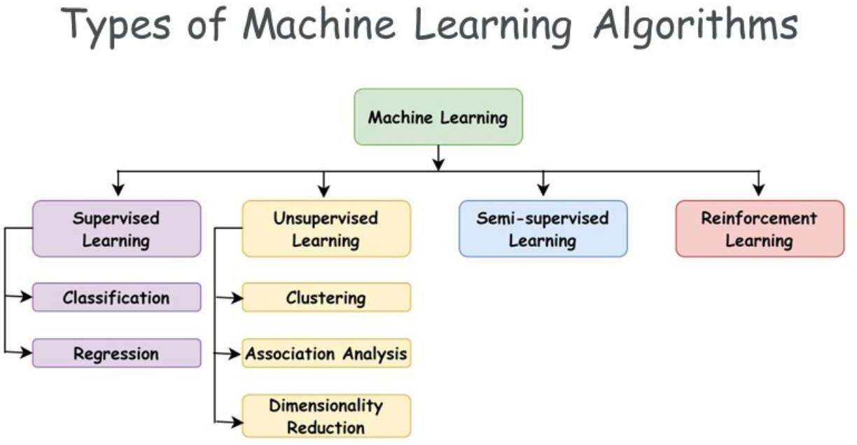

Slide 6
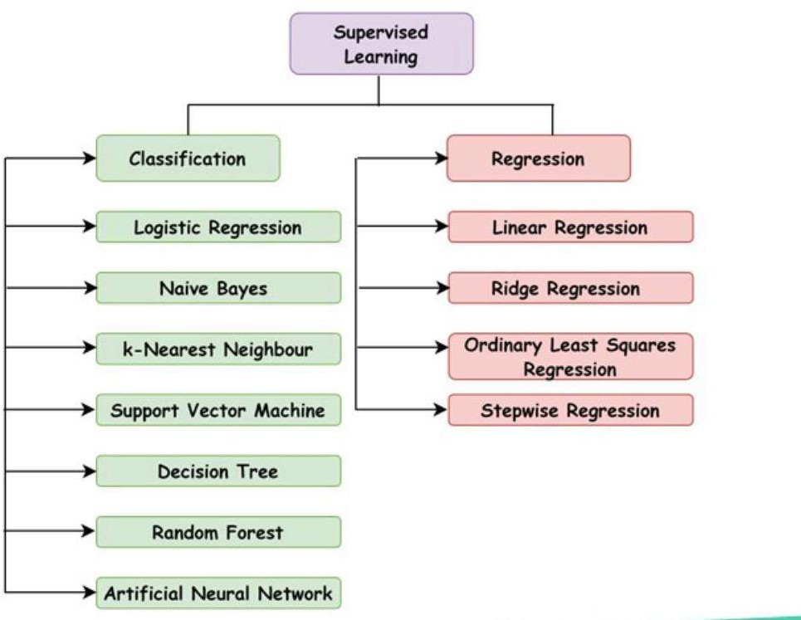

Slide 7


Slide 8
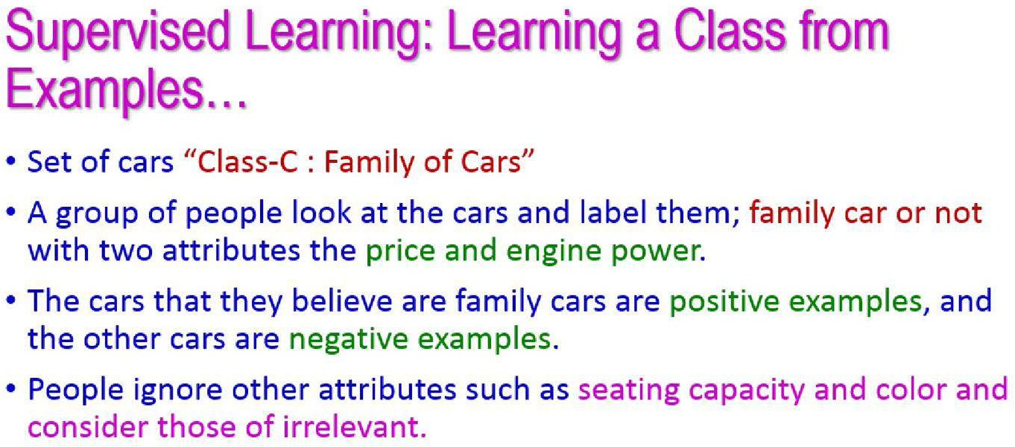

Slide 9
LEARNING A CLASS FROM EXAMPLES
Class C of a “family car”
Prediction: Is car x a family car?
Knowledge extraction:What do people expect from a family car?
Output:
Positive (+) and negative (–) examples
Input representation:
x₁: price, x₂ : engine power
10

Slide 10
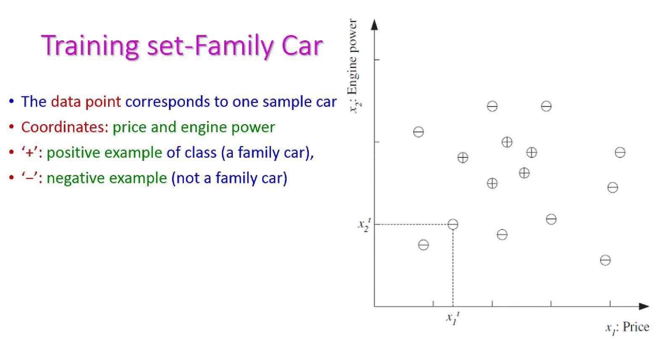
11

Slide 11
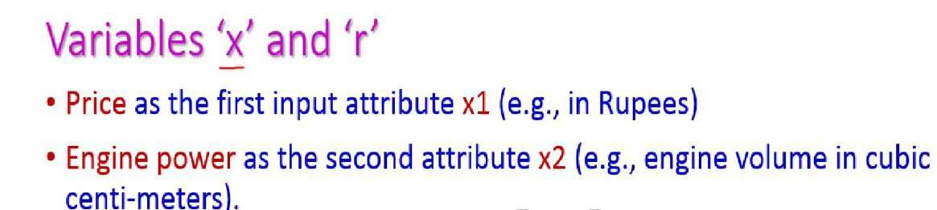
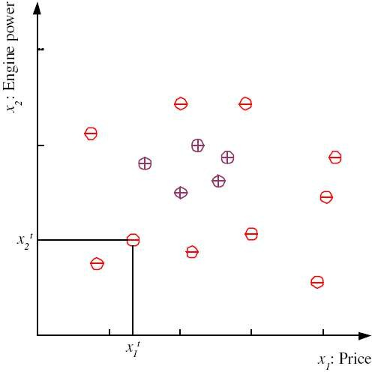
⎧ 1 if x is positive
⎡ x₁ ⎤
x = ⎢
⎥
r = ⎨
⎣^{x}2 ⎦
⎩0 if x is negative
t t N
X = {x ,r }
t =1
12

Slide 12
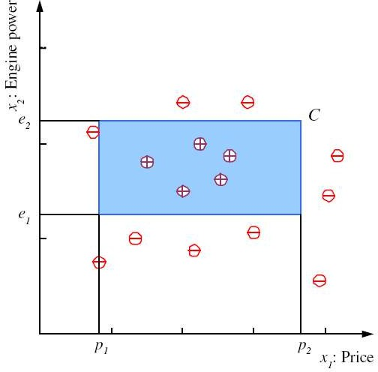
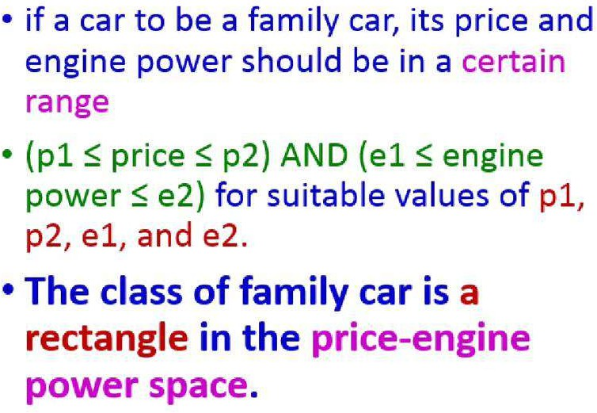
CLASS C
13

Slide 13
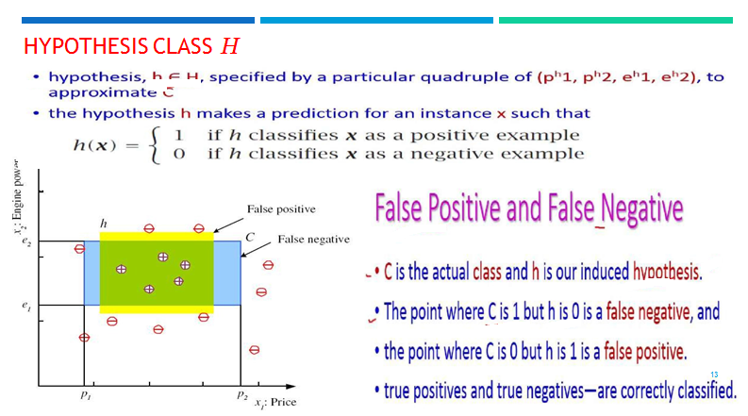

Slide 14
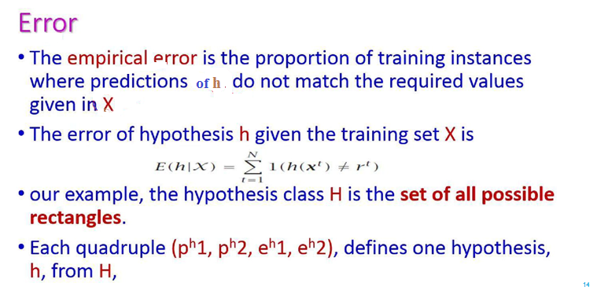

Slide 15
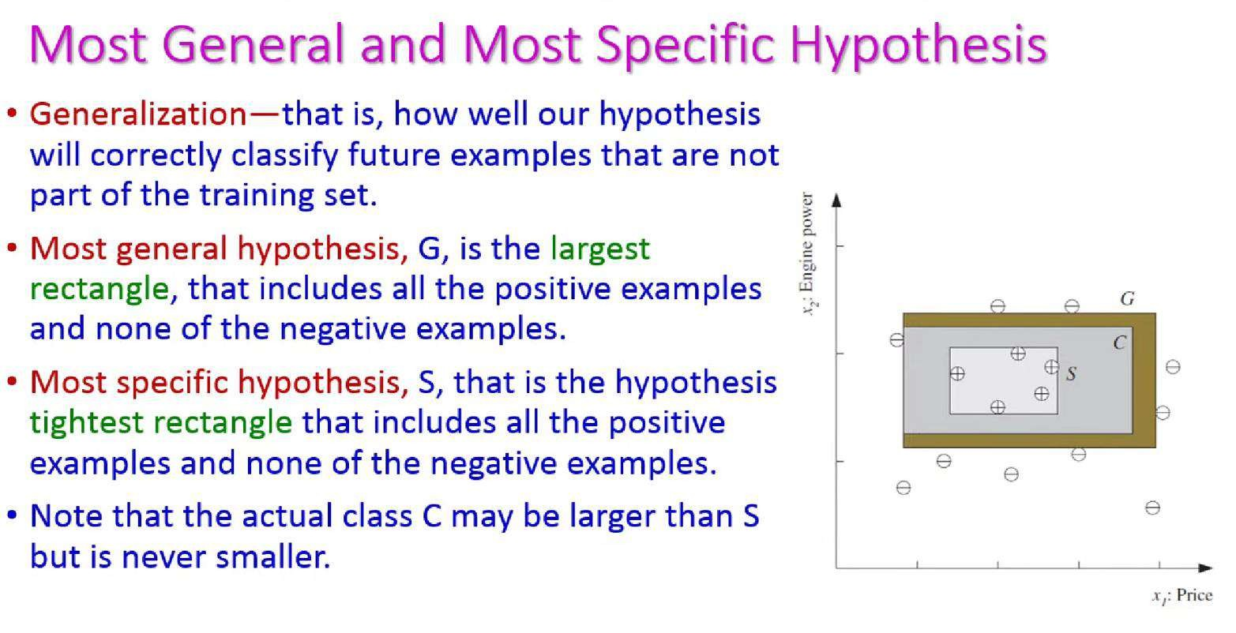

Slide 16
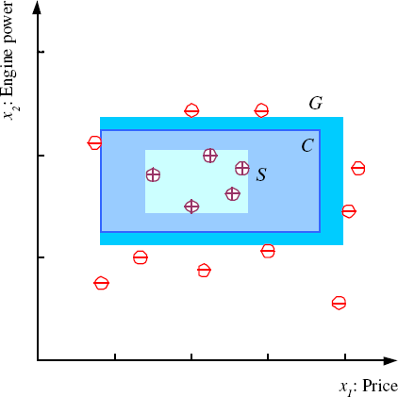
S, G, AND THE VERSION SPACE
most specific hypothesis, S
most general hypothesis, G
h ∈ H, between S and G is consistent
and make up the version space (Mitchell, 1997)
17

Slide 17
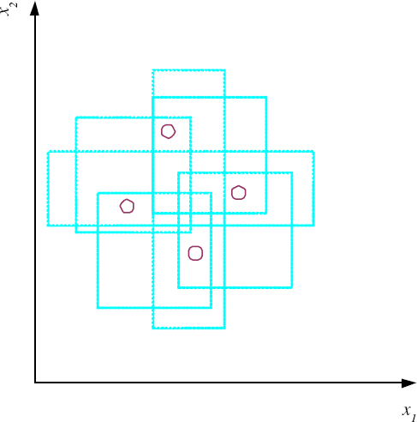
VC DIMENSION
N points can be labeled in 2^{N} ways as +/–
H shatters N if there exists h ∈ H consistent
for any of these:
VC(H ) = N
An axis-aligned rectangle shatters 4 points only !
17

Slide 18

Single class problem
Consider only one single class While learning the examples are called single class problem

Slide 19
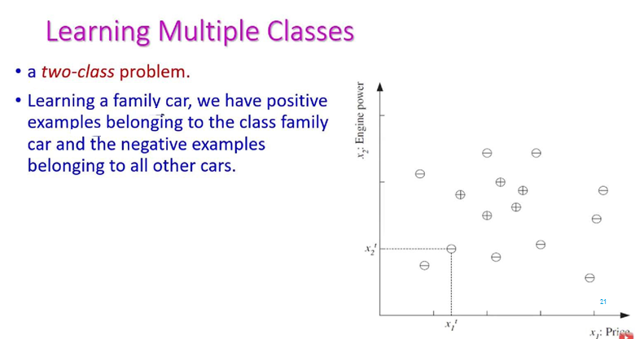

Slide 20
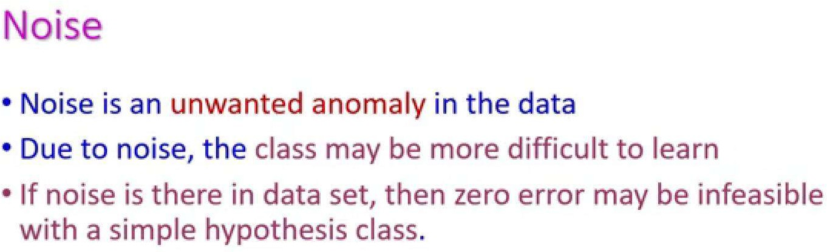

Slide 21
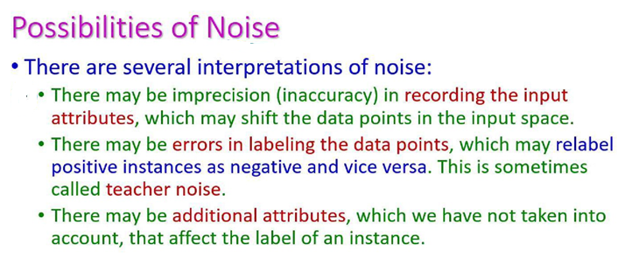

Slide 22
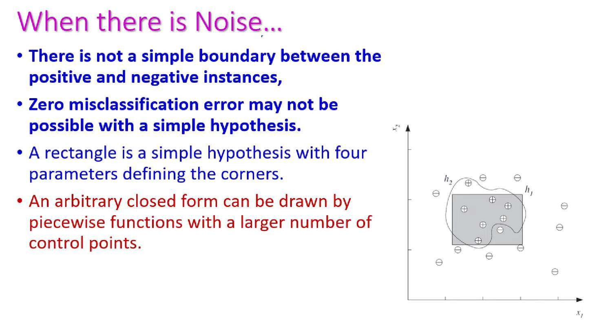

Slide 23
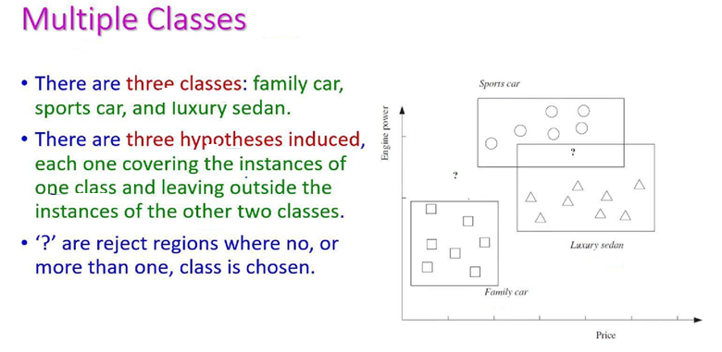

Slide 24
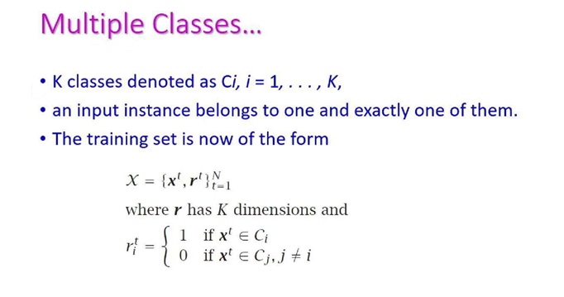

Slide 25
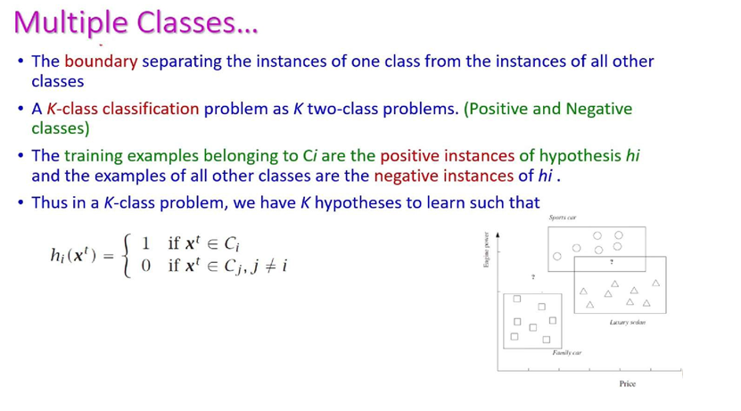

Slide 26
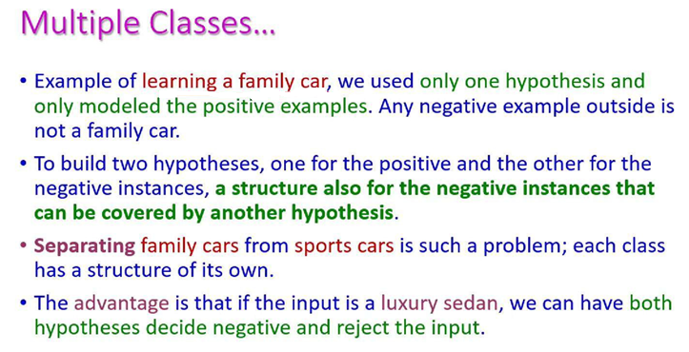

Slide 27
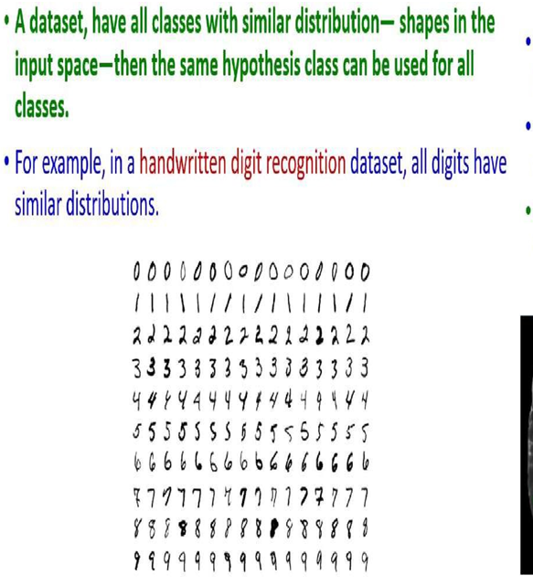

Slide 28
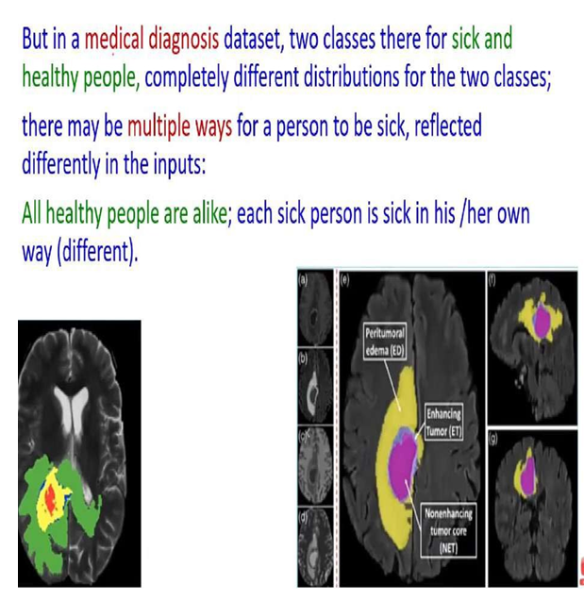

Slide 29
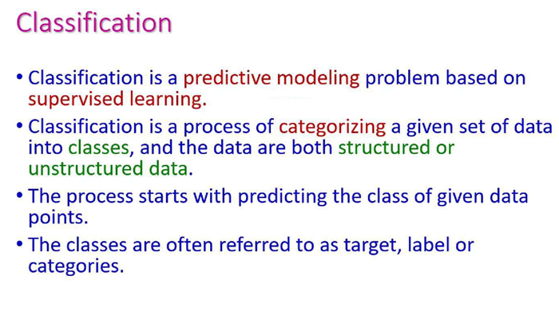

Slide 30
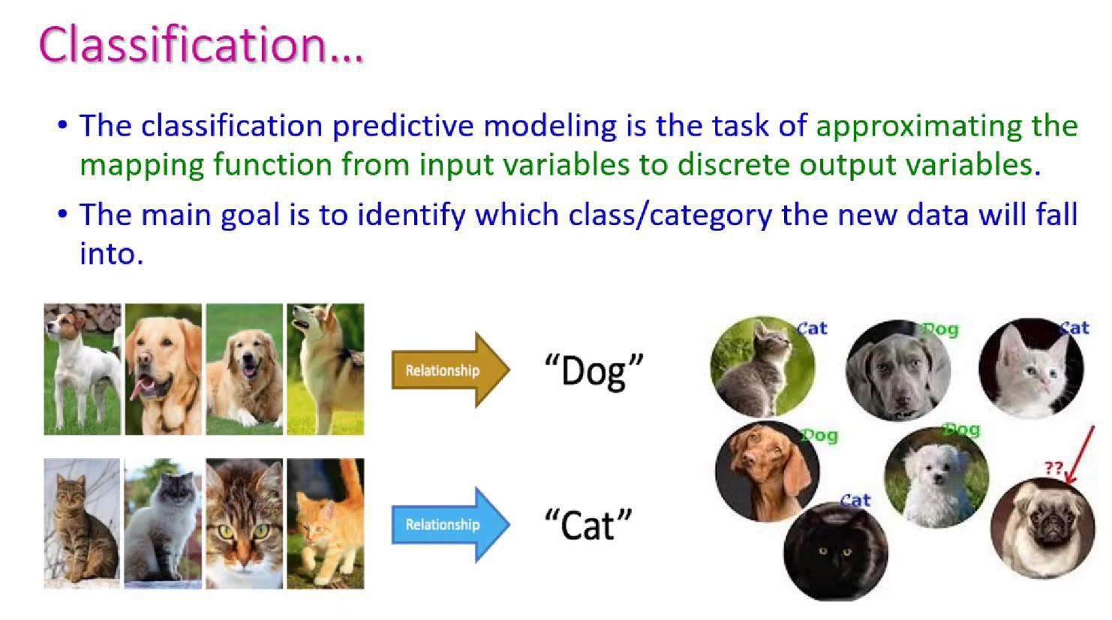

Slide 31
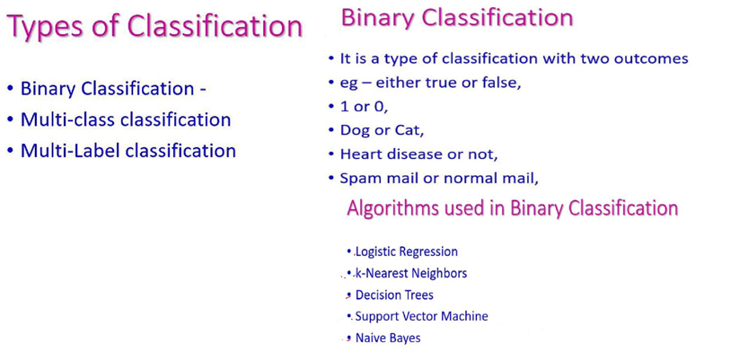

Slide 32
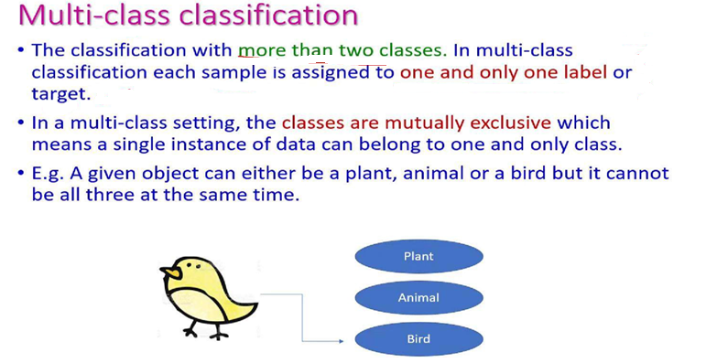

Slide 33
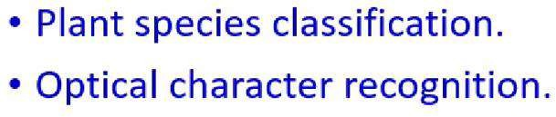

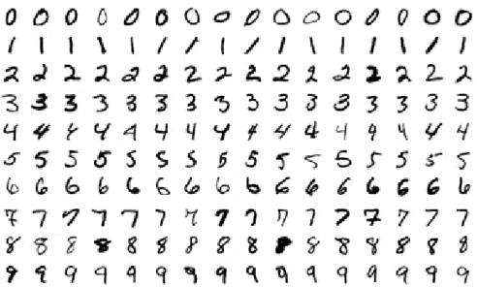

Slide 34
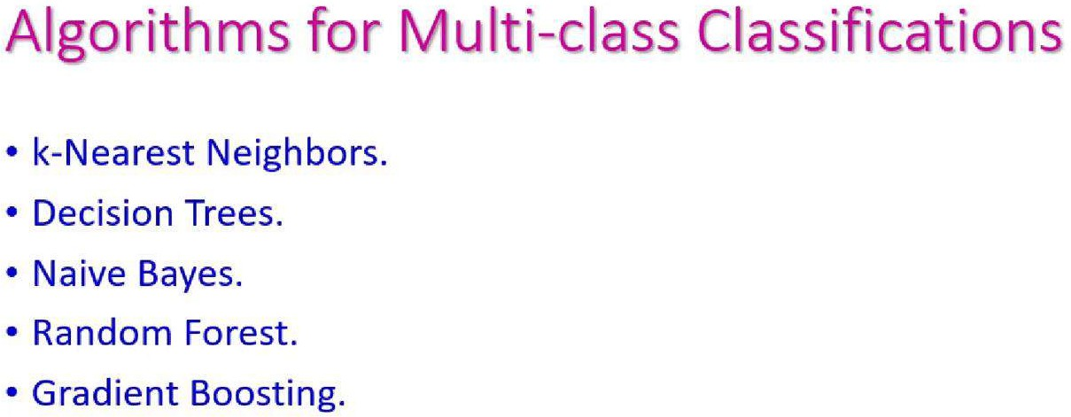

Slide 35
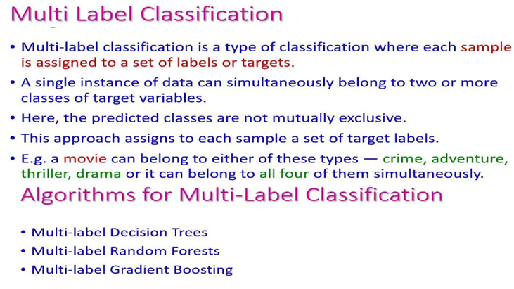

Slide 36
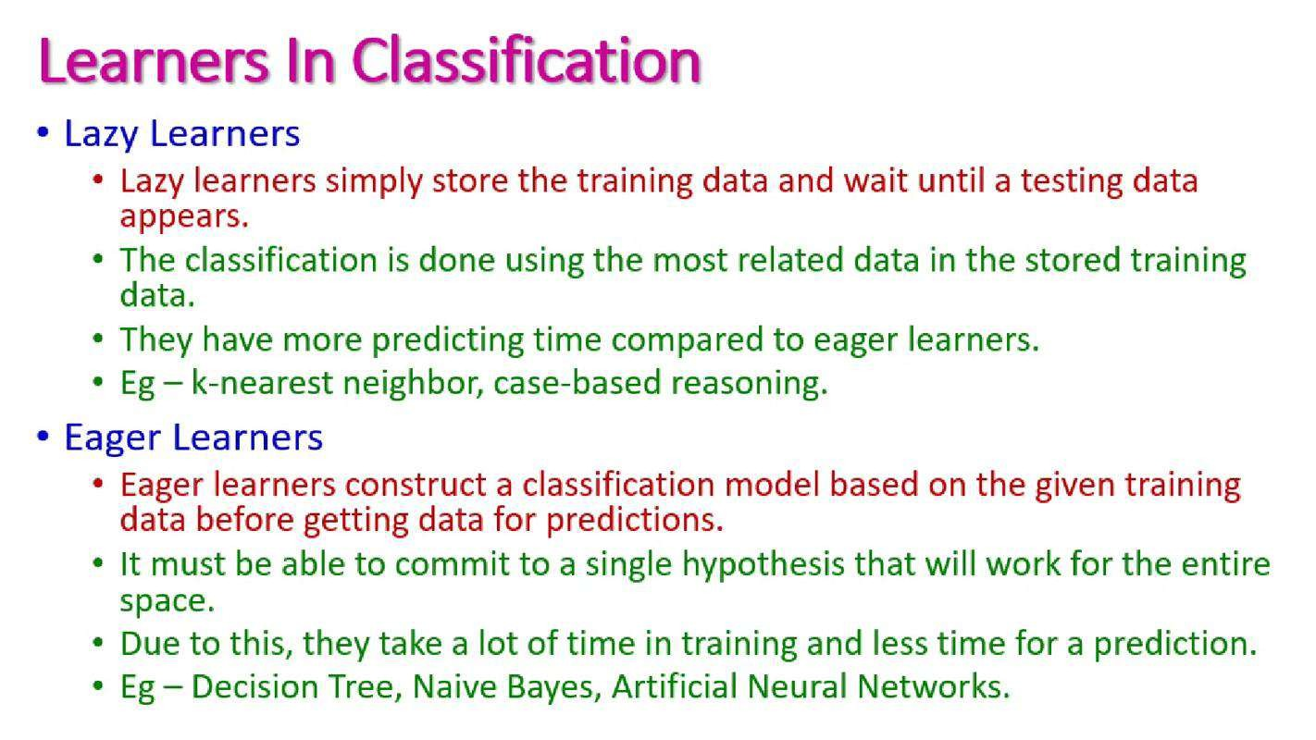

Slide 37
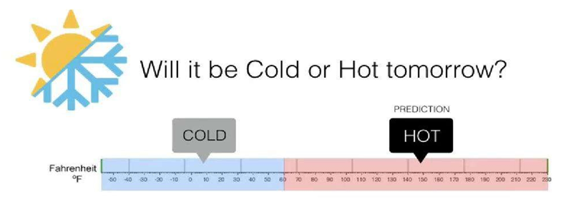

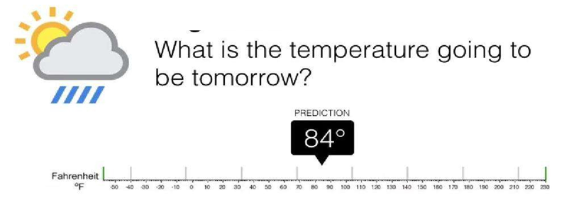


Slide 38
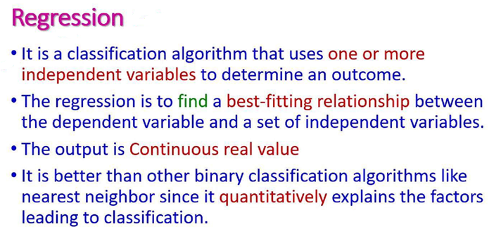

Slide 39
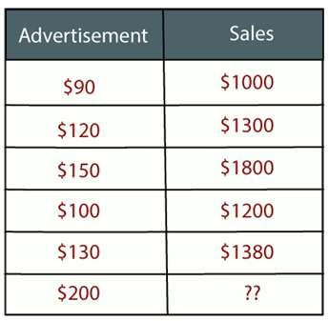
REGRESSION
Regression is a supervised learning technique which helps in finding the correlation between variables and enables us to predict the continuous output variable based on the one or more predictor variables.
It is mainly used for prediction, forecasting, time series modeling, and determining the causal-effect relationship between variables.
"Regression shows a line or curve that passes through all the datapoints on target-predictor graph in such a way that the vertical distance between the datapoints and the regression line is minimum.“
Example : Prediction of rain using temperature and other factors
Determining Market trends
Prediction of road accidents due to rash driving.
42

Slide 40

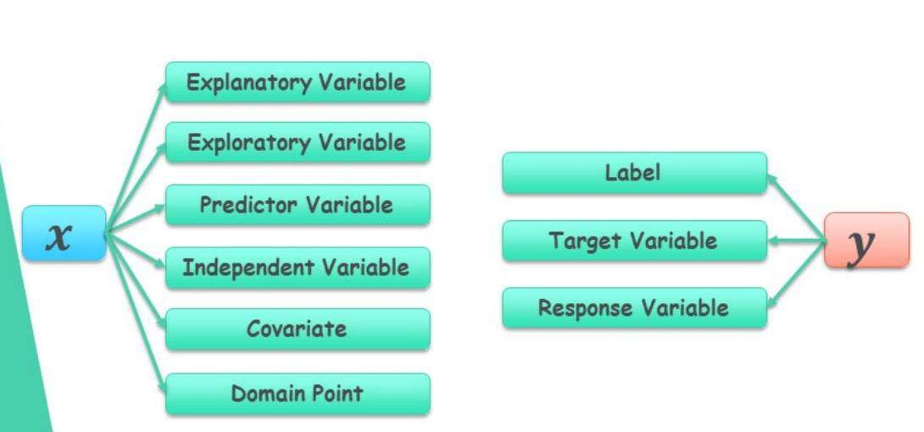
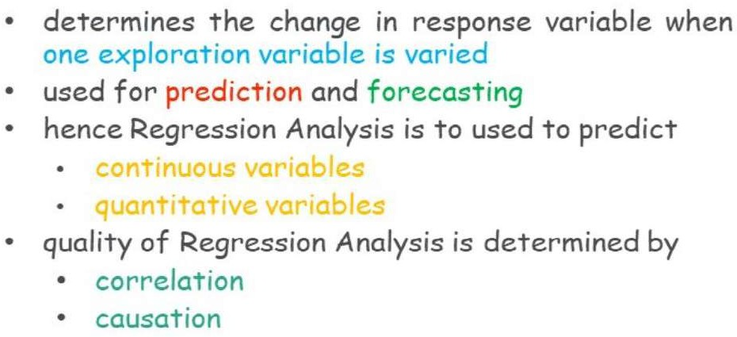

Slide 41
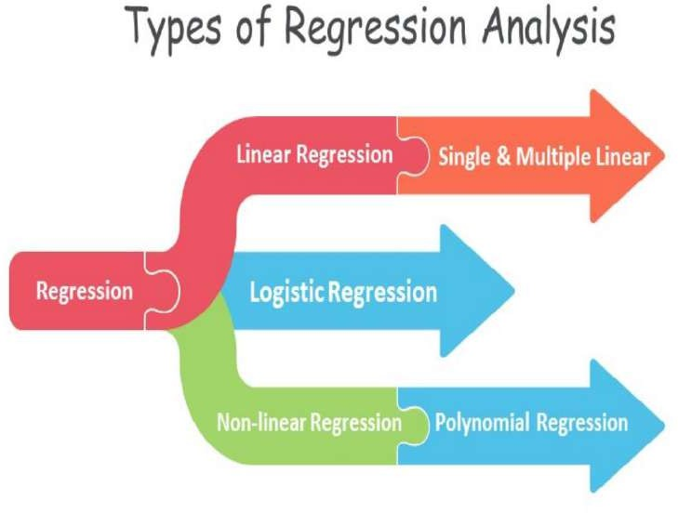
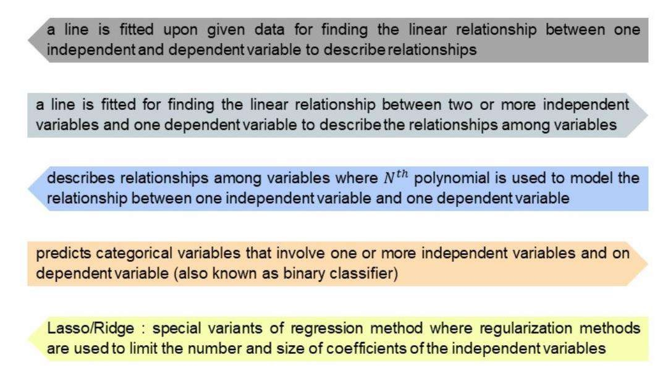

Slide 42
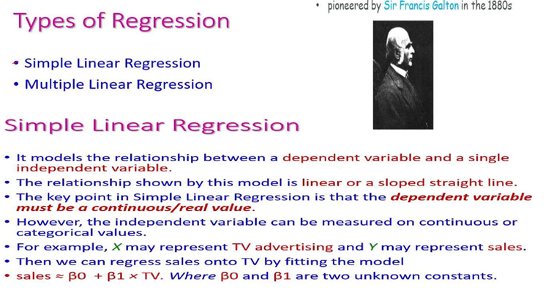

Slide 43
LINEAR REGRESSION:
Linear regression is a statistical regression method which is used for predictive analysis.
It is one of the very simple and easy algorithms which works on regression and shows the relationship between the continuous variables.
It is used for solving the regression problem in machine learning.
Linear regression shows the linear relationship between the independent variable (X-axis) and the dependent variable (Y-axis), hence called linear regression.
If there is only one input variable (x), then such linear regression is called simple linear regression. And
if there is more than one input variable, then such linear regression is called multiple linear regression.

Slide 44
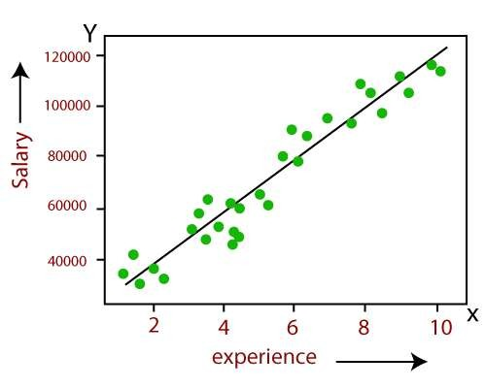
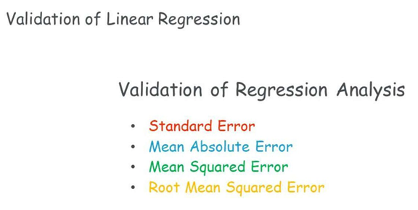
LINEAR REGRESSION CONT..
Y= aX+b
Here, Y = dependent variables (target variables),
X= Independent variables (predictor variables),
a and b are the linear coefficients
Some popular applications of linear regression are:
Analyzing trends and sales estimates
Salary forecasting
Real estate prediction
Arriving at ETAs in traffic.
48

Slide 45
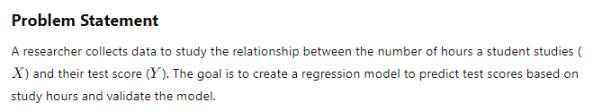
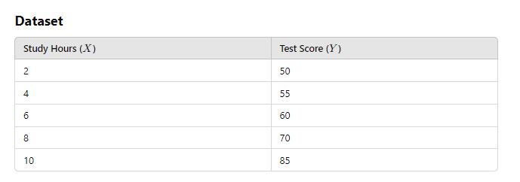
Simple Linear regress – Example with validation

Slide 46
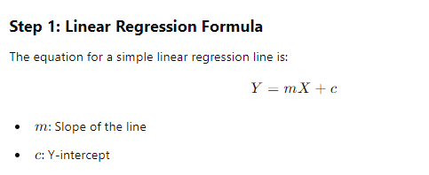
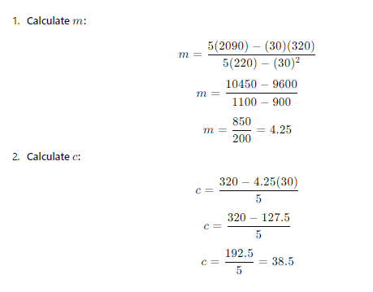
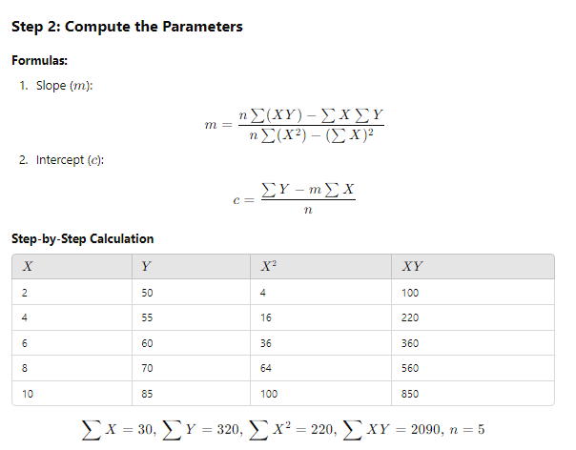

Slide 47
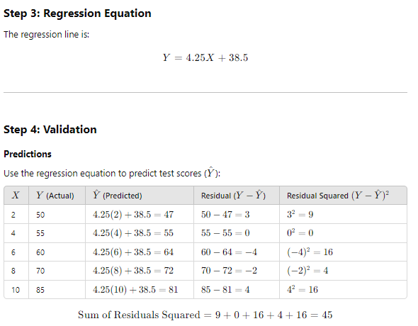

Slide 48
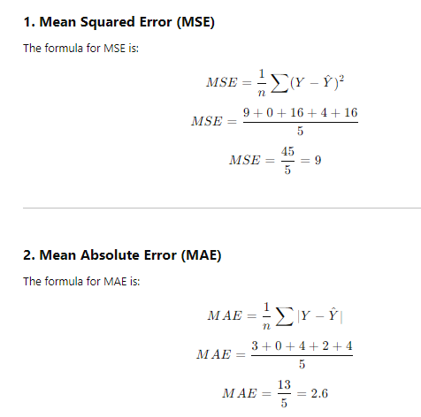
Evaluation metrics applied
Mean Squared Error (MSE): 9
Measures the average squared difference between actual values and predicted values.
Suggestion : The smaller the MSE, the better the model's predictions.
Analysed as Average, if the error increases, then it will impact the produced output due to outliers
Mean Absolute Error (MAE): 2.6
Measures the average absolute difference between actual and predicted values.
MAE is easier to interpret because it represents the error in the same unit as the dependent variable.
An MAE of 2.6 means the model's predictions are, on average, 2.6 points away from the actual test scores.

Slide 49

Root Mean Squared Error (RMSE): 3
The square root of MSE, providing an error measure in the same unit as the dependent variable.
RMSE emphasizes larger errors more than MAE due to squaring residuals before averaging.
An RMSE of 3 indicates that the typical prediction error is about 3 points, making it comparable to MAE. This is the recommended evaluation metric
Standard Error (SE): 3.87
Measures the average deviation of the predicted values from the regression line, adjusted for the number of data points (n).
:
SE quantifies how well the model fits the sample data.
An SE of 3.87 suggests that the regression line deviates by roughly 3.87 points from the actual data points on average.
Lower SE values indicate a tighter fit.

Slide 50


Slide 51




Slide 52







Slide 53


Slide 54


Slide 55

MULTIPLE LINEAR REGRESSION
Multiple Linear Regression is one of the important regression algorithms which models the linear relationship between a single dependent continuous variable and more than one independent variable.
Prediction of CO₂ emission based on engine size and number of cylinders in a car.
For MLR, the dependent or target variable(Y) must be the continuous/real, but the predictor or
independent variable may be of continuous or categorical form.
Each feature variable must model the linear relationship with the dependent variable.
MLR tries to fit a regression line through a multidimensional space of data-points.
63

Slide 56
Algorithms
Examples for Regression
Examples for Regression
House price prediction
Analyzing stock markets
Predicting energy consumptions
Experience and salary analysis
KNN regression
SV regression
Gradient Boosting regression
DT regression

Slide 57
Check out the pdf attached..

Slide 58
LOGISTIC REGRESSION:
Logistic regression is another supervised learning algorithm which is used to solve the classification problems.
In classification problems, we have dependent variables in a binary or discrete format such as 0 or 1.
Logistic regression algorithm works with the categorical variable such as 0 or 1, Yes or No, True or False, Spam or not spam, etc.
It is a predictive analysis algorithm which works on the concept of probability.
Logistic regression is a type of regression, but it is different from the linear regression algorithm in the term how they are used.
Logistic regression uses sigmoid function or logistic function which is a complex cost function. This sigmoid function is used to model the data in logistic regression.
76

Slide 59


LOGISTIC REGRESSION:
f(x)= Output between the 0 and 1 value.
x= input to the function
e= base of natural logarithm.
It uses the concept of threshold levels, values above the threshold level are rounded up to 1, and values below the threshold level are rounded up to 0.
There are three types of logistic regression:
Binary(0/1, pass/fail)
Multi(cats, dogs, lions)
O₇₇ rdinal(low, medium, high)

Slide 60
predicts two maximum values (0 or 1).
In Logistic regression, instead of fitting a regression line, we fit an “S” shaped logistic function, which
The sigmoid function is a mathematical function used to map the predicted values to probabilities.
It maps any real value into another value within a range of 0 and 1. The value of the logistic regression must be between 0 and 1, which cannot go beyond this limit, so it forms a curve like the “S” form.
The S-form curve is called the Sigmoid function or the logistic function.
In logistic regression, we use the concept of the threshold value, which defines the probability of either 0 or 1. Such as values above the threshold value tends to 1, and a
value below the threshold values tends to 0
78

Slide 61
Problem: the probability of being infected given the range of age (20 to 50)
solve this problem using Linear Regression
Given age= 20 between 55
Note: 0<=p<=1 //The probability value should range from 0 to 1.
We have y= β0 + β1*X1 // linear regression equation
Case 1: β0 =-1.700, β1 =0.064, age=35 //β0 is the y-intercept and β1 is the slope of the straight line drawn. Β0 and β1 are randomly chosen.
Let us try to plug in the values to the straight-line equation we have and observe the corresponding results.
y=-1.700+0.066(35) = 0.54
Case 2: for age 25 and 45
y=-1.700+0.064(25)= -0.09 //negative result
y=-1.700+0.064(45)= 1.20 //value is more than 1
We have noticed that, for the age 25, the final value of the equation is less than 0 and for the age 45, the final value of the equation is greater than 1
Linear regression is only dealing with continuous variables . The problem of Linear Regression is that these predictions are no₇t₉ sensible for classification since the true probability must fall between 0 and 1 but it can be larger than 1 or smaller than 0.

Slide 62


fundamentals of statistical terms — Probability and Odds.
The probability that an event will occur is the fraction of times you expect to see that event in many trials. If the probability of an event occurring is Y, then the probability of the event not occurring is 1-Y. Probabilities always range between 0 and 1.
The odds are defined as the probability that the event will occur divided by the probability that the event will not occur. Unlike probability, the odds are not constrained to lie between 0 and 1, but can take any value from zero to infinity.
If the probability of Success is P, then the odds of that event is:
Example:
If the probability of success (P) is 0.60 (60%),
then the probability of failure(1-P) is 1–0.60 = 0.40(40%).
Then the odds are 0.60 / (1–0.60) = 0.60/0.40 = 1.5.
80

Slide 63


Transform the model from linear regression to logistic regression using the logistic function.

Slide 64


Slide 65


Slide 66


Slide 67


Slide 68


Slide 69


Example -2

Slide 70


Slide 71


Slide 72



Slide 73

Evaluation of the logistic regression – Confusion matrix

Slide 74


Slide 75



Calculate the following
Accuracy = 2+0 / 5 =2/5 = 2.5
Precision = 2/5 = 2.5
Recall = 2/2 = 1
Recall : Measures the model's ability to detect actual disease cases.High recall ensures fewer missed cases, crucial in disease prediction.

Slide 76




Slide 77


Example – 3

Slide 78

Check out is your answer correct..
Now evaluate the metrics to check for the models ability…

Slide 79



Task -1

Slide 80

Difference between Linear Regression and Logistic Regression

Slide 81


Slide 82
Bayes’ theorem
Bayes' theorem provides us with a formula to calculate probability of an event given probabilities of other events.
This theorem determines the probability of an event with uncertain knowledge.
Bayes' theorem was named after the British mathematician Thomas Bayes.
The Bayesian inference is an application of Bayes' theorem, which is fundamental to Bayesian statistics.
Bayes' theorem allows updating the probability prediction of an event by observing new information of the real world.

Slide 83
Example: If rainfall corresponds to temperature of a region, then by using Bayes' theorem, we can determine the probability of getting rainfall more accurately with the help of temperature.
(I.e) one factor is depending on other factor.

Slide 84

Bayes' theorem can be derived using product rule and conditional probability of event A with known event B:
As from product rule we can write:
P(A ⋀ B)= P(A|B) P(B) or
Similarly, the probability of event B with known event A:
P(A ⋀ B)= P(B|A) P(A)
Equating right hand side of both the equations, we will get:
This equation is called Bayes’ rule or Bayes’ theorem

Slide 85
P(A|B) is known as posterior, which we need to calculate, and it will be read as Probability of hypothesis A when we have occurred an evidence B.
P(B|A) is called the likelihood, in which we consider that hypothesis is true, then we calculate the probability of evidence.
P(A) is called the prior probability, probability of hypothesis before considering the evidence
P(B) is called marginal probability, pure probability of an evidence.

Slide 86

Applying Bayes' rule:
Bayes' rule allows us to compute the single term P(B|A) in terms of P(A|B), P(B), and P(A). This is very useful in cases where we have a good probability of these three terms and want to determine the fourth one. Suppose we want to perceive the effect of some unknown cause, and want to compute that cause, then the Bayes' rule becomes:

Slide 87

Example-1:
Question: what is the probability that a patient has diseases meningitis with a stiff neck?
Given Data:
A doctor is aware that disease meningitis causes a patient to have a stiff neck, and it occurs 80% of the time. He is also aware of some more facts, which are given as follows:
The Known probability that a patient has meningitis disease is 1/30,000.
The Known probability that a patient has a stiff neck is 2%.
Solution:
Let a be the proposition that patient has stiff neck and b be the proposition that patient has meningitis. , so we can calculate the following as:
P(a|b) = 0.8
P(b) = 1/30000
P(a)= .02
Hence, we can assume that 1 patient out of 600 patients has meningitis disease with a stiff neck.

Slide 88


Example-2:
Question: From a standard deck of playing cards, a single card is drawn. The probability that the card is king is 4/52, then calculate posterior probability P(King|Face), which means the drawn face card is a king card.
Solution:
P(king): probability that the card is King= 4/52= 1/13
P(face): probability that a card is a face card= 3/13
P(Face|King): probability of face card when we assume it is a king = 1
Putting all values in the above formula we will get:

Slide 89



Slide 90
Homework
You are planning a picnic today, but the morning is cloudy
Oh no! 50% of all rainy days start off cloudy!
But cloudy mornings are common (about 40% of days start cloudy)
And this is usually a dry month (only 3 of 30 days tend to be rainy, or 10%)
What is the chance of rain during the day?

Slide 91


Slide 92
NAIVE BAYES CLASSIFIER
Naïve Bayes algorithm is a supervised learning algorithm, which is based on Bayes theorem and used for solving classification problems.
It is mainly used in text classification that includes a high-dimensional training dataset.
Naïve Bayes Classifier is one of the simple and most effective Classification algorithms which helps in building the fast machine learning models that can make quick predictions.
It is a probabilistic classifier, which means it predicts on the basis of the probability of an object.
Some popular examples of Naïve Bayes Algorithm are spam filtration, Sentimental analysis, and classifying articles.
97

Slide 93
Assumption of Naive Bayes
The fundamental Naive Bayes assumption is that each feature makes an:
Feature independence: The features of the data are conditionally independent of each other, given the class label.
Continuous features are normally distributed: If a feature is continuous, then it is assumed to be normally distributed within each class.
Discrete features have multinomial distributions: If a feature is discrete, then it is assumed to have a multinomial distribution within each class.
Features are equally important: All features are assumed to contribute equally to the prediction of the class label.
5. No missing data: The data should not contain any missing values.
98

Slide 94


Example for Bayesian Classifier

Slide 95


Slide 96


Slide 97


Slide 98



Slide 99


Slide 100

The evaluation metrics to find the performance of Bayes Classifier includes
Confustion matrix
Accuaracy
Precision
Recall
Specificity
F1 score and
Log loss

Slide 101

Task 1

Slide 102

Task -2

